Slide 1
Soft Real-Time Systems
CPEN 432 – Real-Time Systems Design

Slide 2
Elastic scheduling of real-time tasks
Ref: Elastic task model for adaptive rate control. Buttazzo, Lipari and Abeni. IEEE Real-Time Systems Symposium, 1998.

Slide 3
Many models for soft real-time systems
Why?
There are a variety of soft real-time systems.
And there are a variety of ways in which their behaviour can be altered.
In a multimedia system…
Frames can be dropped, i.e., jobs can be skipped.
Alternatively, it is possible to reduce the frame rate.
Move from 60 fps to 30 fps or to 24 fps.
We are changing the periodicity of a task.
The elastic task model provides a natural abstraction for such tasks.

Slide 4
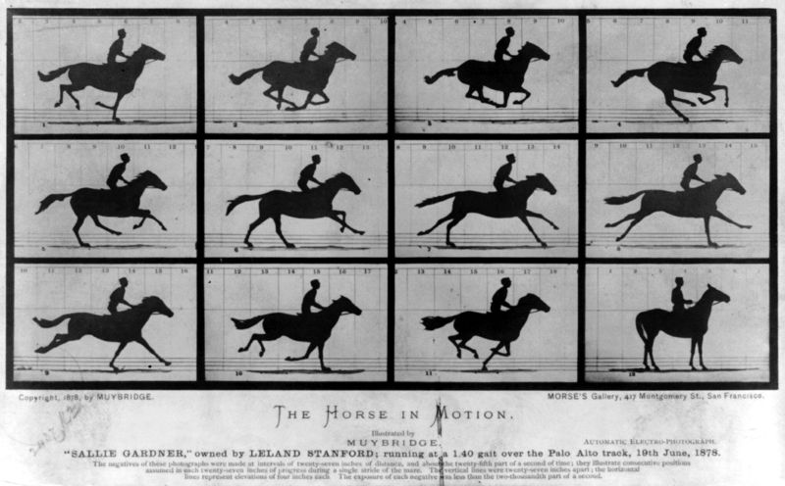
Eadweard Muybridge
Notes:
Back in 1872, Leland Stanford made a bet that for a moment, all four of a racehorse's hooves are off the ground simultaneously, and he hired Muybridge to take the pictures to prove him right.
Muybridge set up a row of cameras with tripwires, each of which would trigger a picture for a split second as the horse ran by. The results settled the debate once and for all: all four hooves do leave the ground at once, as the top middle image in this sequence demonstrates.

Slide 5
Elastic task scheduling
What if we need all jobs to meet their deadlines... Even if this entails allowing tasks to execute at lower frequencies (higher periods)?
Then we need to understand
When should we increase task periods?
And increase the periods by what extent?
And for which tasks?

Slide 6
Task model for elastic scheduling
For each task T_{i} :
There is an operating period range [P_{i,min}, P_{i,max}]
P_{i,min} is the best possible period
There is also a value P_{i,0} that represents a nominal period
This nominal period is preferred when we can not run the task at the best possible period
For a hard real-time task:
P_{i,min} = P_{i,max} = P_{i,0}
If P_{i,0} = P_{i,max} and P_{i,min} << P_{i,max}, the task is very flexible (highly elastic)
Only periods can be varied; execution times are constant

Slide 7
Task model for elastic scheduling
For each task T_{i} :
There is also an elasticity factor k_{i} that represents the flexibility of the task [how much it prefers to stay close to nominal]
k_{i} = 0: T_{i} would always stay at nominal period (hard real-time)
k_{i} large relative to other tasks: T_{i} relatively flexible in being stretched away from nominal period
Additional parameters
Task | e_{i} | P_{i,0} | P_{i,min} | P_{i,max} | k_{i}
T₁ | 10 | 20 | 20 | 25 | 1
T₂ | 10 | 40 | 40 | 50 | 1
T₃ | 15 | 70 | 35 | 80 | 1
Notes:
k_i: flexibility, pliability, or willingness to be slowed down. If a task has a high a small k_i, it might be like “sure, I can have my period increased, but only if reluctantly so; if you really need to (i.e., there is a severe overload situation).

Slide 8
Schedulability analysis
We will assume utilization bounds are used for testing schedulability.
Depending on the scheduling policy, we know the utilization bound U_{b}
The goal of the elasticity is to ensure that the utilization of the set of tasks does not exceed U_{b}
Of course, we need to scale down task utilizations if the processor utilization threatens to exceed U_{b} (for instance, when we add a new task)
How do we scale down task utilizations?

Slide 9
An example
Task | e_{i} | P_{i,0} | P_{i,min} | P_{i,max} | k_{i}
T₁ | 10 | 20 | 20 | 25 | 1
T₂ | 10 | 40 | 40 | 50 | 1
T₃ | 15 | 70 | 35 | 80 | 1
Is this task set schedulable using EDF?
If each task were to use its nominal period then:
U = 10/20 + 10/40 + 15/70 = 0.964 < 1.
To improve the QoS for T₃, we would like to use a period of 50 (between 35 and 80):
U = 10/20 + 10/40 + 15/50 = 1.05 > 1.
We could adjust the periods of T₁ (set to 22) and T₂ (set to 45):
U = 10/22 + 10/45 + 15/50 = 0.977.
The adjustment seems ad hoc. Can we systematically adjust task periods?

Slide 10
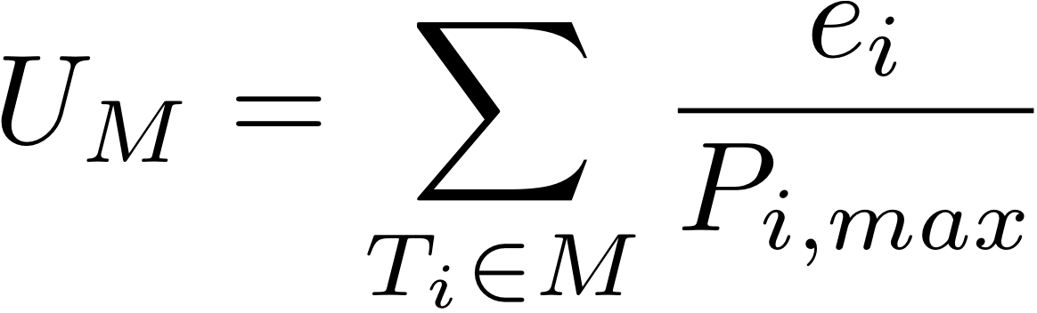
Period adjustment (rate adaptation): Compression
At time instant t, suppose we have an overload condition so that the system utilization is > U_{b}
Need to compress task utilizations (increase periods) to bring system utilization down to U_{b}
At time instant t, let us suppose that task T_{i} is operating with period P_{i}
Some of the tasks could be operating at the highest possible period P_{i} = P_{i,max} (slowest possible rate)
We cannot increase the periods of these tasks
Denote this set of tasks by M
If the utilization bound is U_{b}, then the remaining tasks – those not in M – cannot have a combined utilization greater than U_{b}-U_{M}.

Slide 11
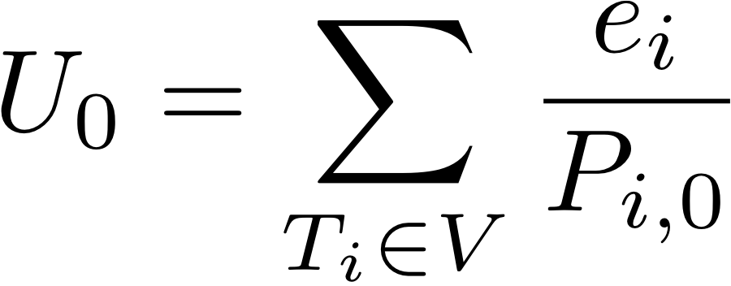
Period adjustment (rate adaptation): Compression
Let the set of tasks with variable/adjustable periods be V.
U₀ is the combined nominal utilization of tasks in set V.
If U₀ +U_{M}=U_{b}, we set the periods of all tasks in V to their nominal periods.
If U₀ +U_{M} > U_{b}, we need to reduce the QoS for some tasks in V below their nominal rate
If U₀ + U_{M} < U_{b}, we set the periods of all tasks in V to their nominal period, and then we use the excess U_{b}-(U_{M} -U₀) to improve the QoS for some tasks
If the utilization bound is U_{b}, then the remaining tasks – those not in M – cannot have a combined utilization greater than U_{b}-U_{M}.
U₀
U_{b}
U_{M}

Slide 12
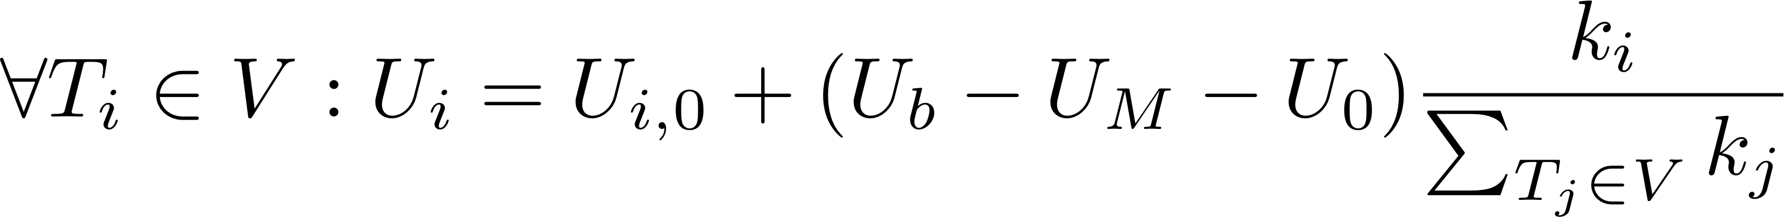
Period adjustment (rate adaptation): Compression
What if U₀ + U_{M} < U_{b}? (cannot give U₀ to variable tasks)
We need to reduce the QoS for some tasks in V below their nominal rate after initially giving them U₀
Note: U_{b} - U_{M} - U₀ < 0
We have to remove a total utilization of (U₀ + U_{M} - U_{b}) from the tasks in V when each operates at its nominal period
proportionately to their relative elasticity
U₀ + U_{M} - U_{b}
U_{b}
U₀
U_{M}

Slide 13
Period adjustment: Compression
What do we do if the adjustment causes a task T_{i} to have a period greater then P_{i,max}?
We have to set the period of that task to P_{i,max},
Remove the task from set V,
Add this task to set M,
And try to adjust the periods once more for the task in V.

Slide 14
Period adjustment: Compression with excess
If U₀ + U_{M} < U_{b} , we can improve the QoS for some tasks beyond their nominal rates
How do we adjust task utilizations?
Use the elasticity coefficients, k_{i}.
The excess capacity is U_{b} – (U_{M} + U₀) > 0. For simplicity we distribute this among tasks in V.
U₀
U_{b}
U_{M}
Notes:
Sum the new U_{i}s:

Slide 15
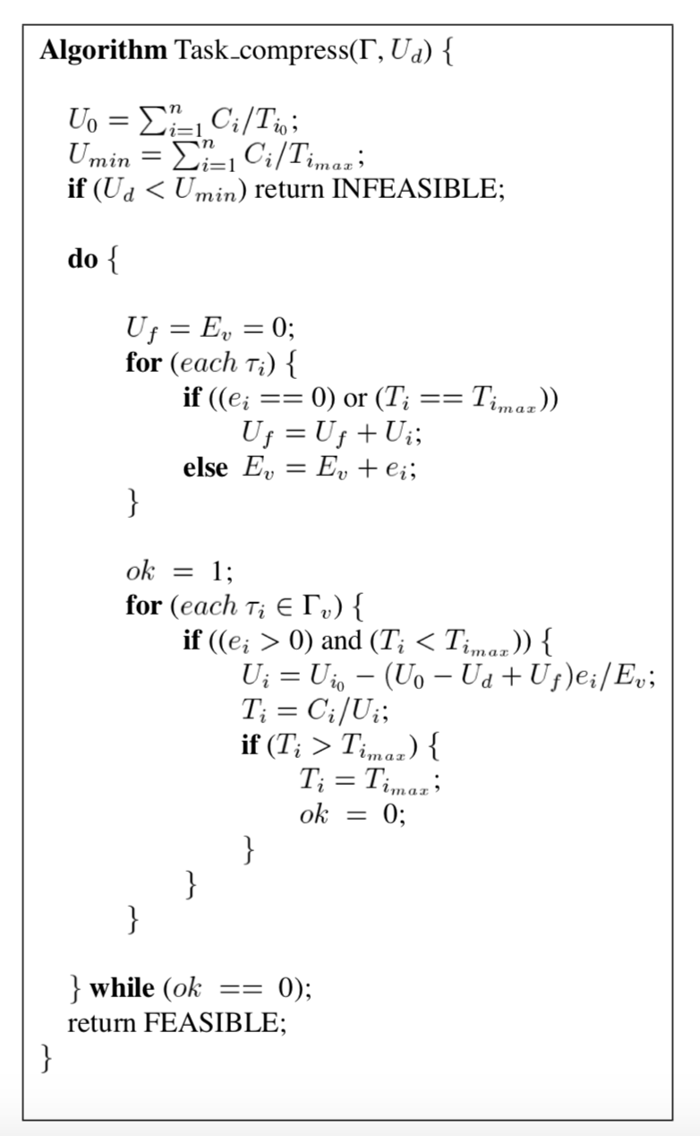
Detailed algorithm
Elastic task model for adaptive rate control. Buttazzo, Lipari and Abeni. RTSS 1998.

Slide 16
Period adjustment: Decompression
At time instant t, suppose overload condition improves so that the system utilization is < U_{b}
Need to decompress task utilizations (decrease periods) to bring system utilization up to U_{b}
At time instant t, let us suppose that task T_{i} is operating with period P_{i}
Let C be the set of tasks that have their utilizations compressed
C = { T_{i}: P_{i} > P_{i,0} }
We wish to decompress tasks in C
Let the set of remaining tasks be A
A: “uncompressed” tasks; A = { T_{i}: P_{i} <= P_{i,0} }

Slide 17
Period adjustment: Decompression
U₀ is the combined nominal utilization of tasks in C.
When decompressing tasks in C, we do not want to degrade the QoS of the tasks in A→ We keep U_{A} fixed
If U₀ +U_{A}=U_{b}, we set the periods of all tasks in C to their nominal periods.
If U₀ +U_{A} > U_{b}, we cannot set all periods in C to nominal → need to reduce QoS for some tasks in C below their nominal rate
If U₀ + U_{A} < U_{b}, we set the periods of all tasks in C to nominal, and then we use the excess (U_{b}-U_{A} -U₀) to improve the QoS for some tasks
If the utilization bound is U_{b}, then the tasks in C cannot have a combined utilization greater than U_{b}-U_{A}.
U_{b}-U_{A}
U₀
U_{b}
U_{A}

Slide 18
Period adjustment: Decompression
If U₀ + U_{A} < U_{b}, we can improve the QoS for some tasks beyond their nominal rates
How do we adjust task utilizations?
Use the elasticity coefficients, k_{i}.
The excess capacity is U_{b} – (U_{A} + U₀) > 0. For simplicity we distribute this among tasks in C.
U₀
U_{b}
U_{A}
Notes:
Sum the new U_{i}s:

Slide 19
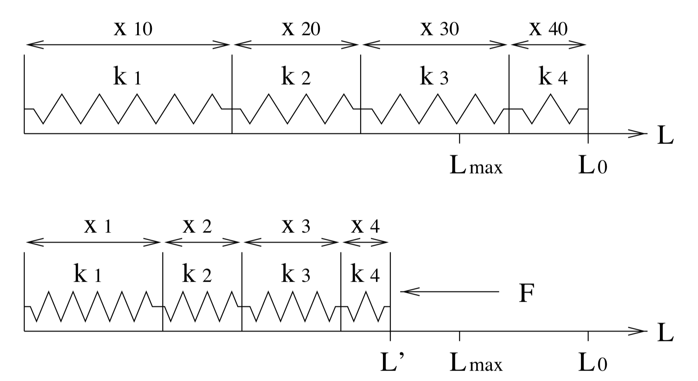
The elasticity analogy
Do not worry about the terminology here.

Slide 20
Compression and decompression
When workload reduces, which may be because a task is complete and is removed from the task set, other tasks can expand or return to their nominal utilizations.
Compression/decompression refer to the utilization of the task.
Increasing the period compresses the utilization.
Decreasing the period expands the utilization.

Slide 21
When do we compress/decompress?
Can we increase or decrease the period of a task at any time instant?
Periods can be increased at any time (immediately).
Periods can be decreased (utilization increased) only at the next release time of the task.
[If you want the detailed proof, consult the reference article.]

Slide 22
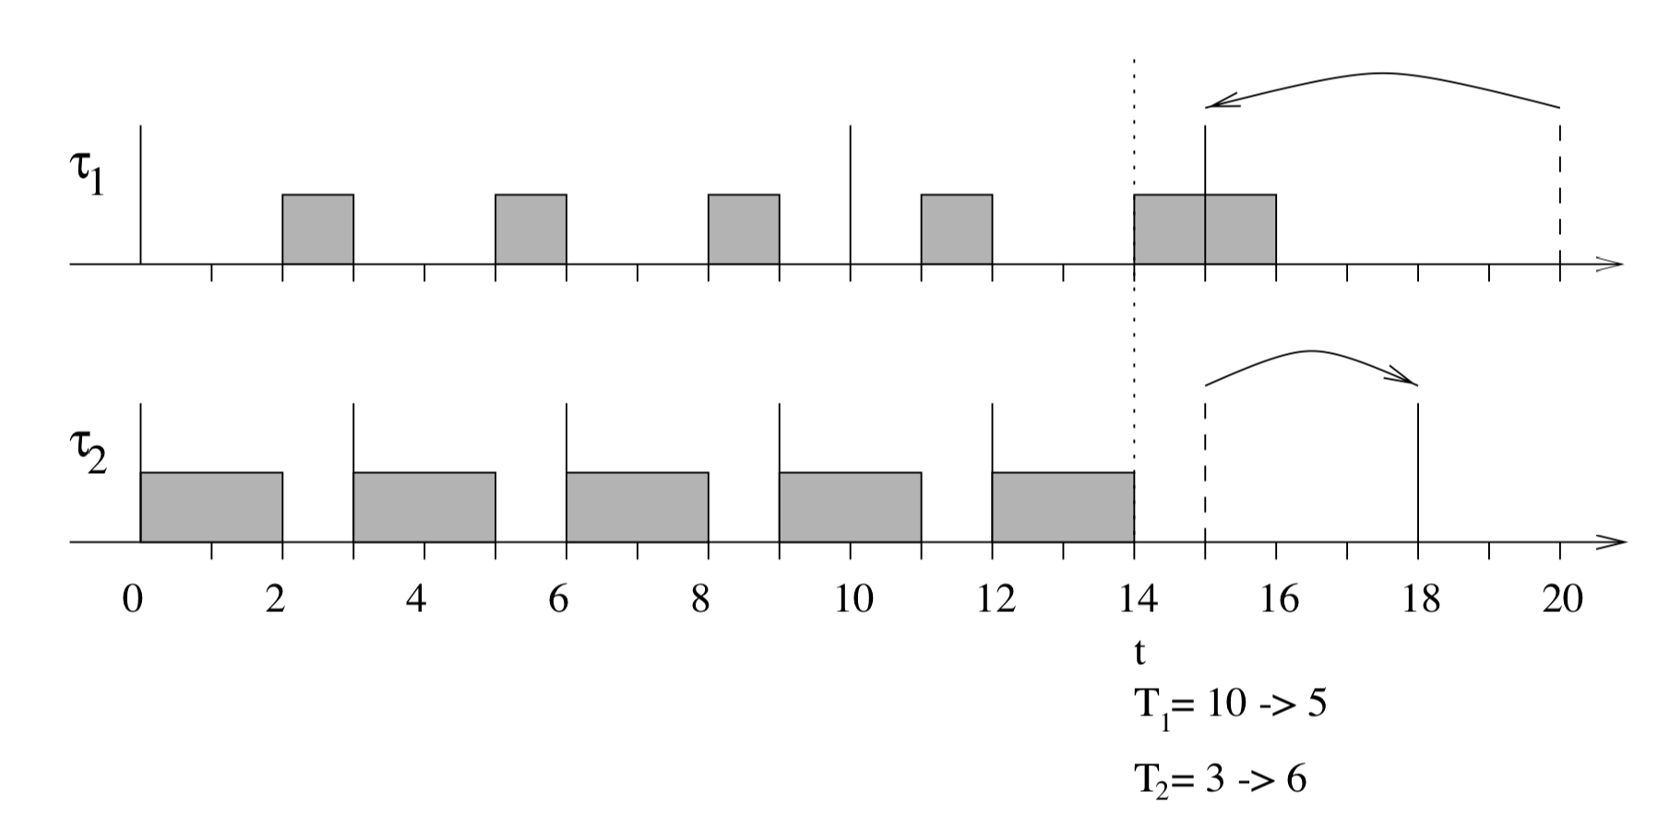
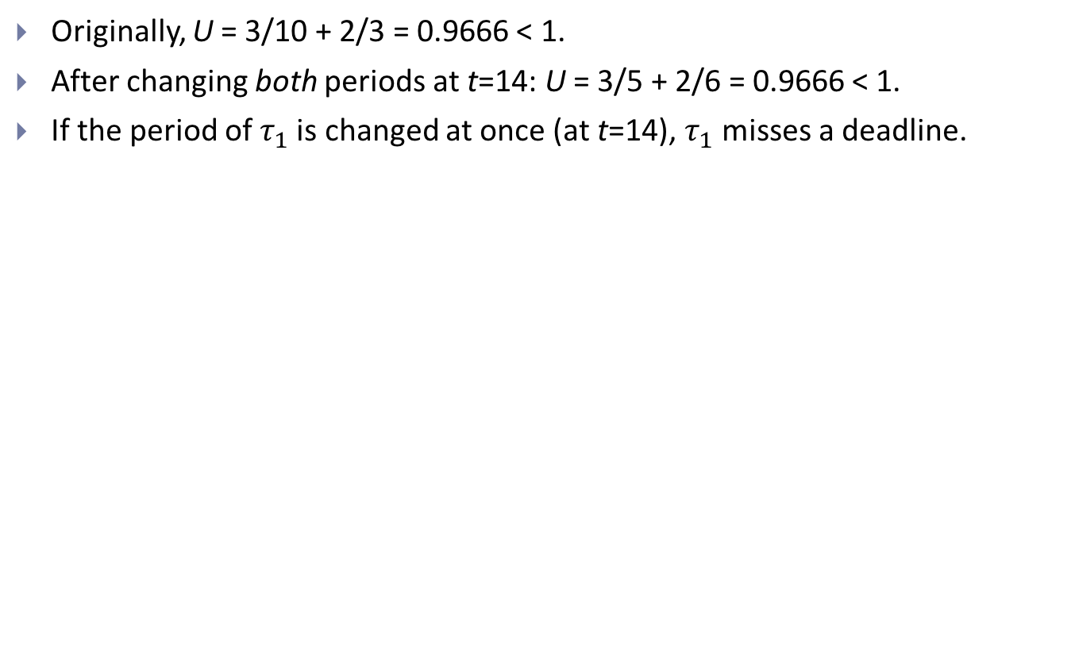
Why decompress at specific instants?
Originally, U = 3/10 + 2/3 = 0.9666 < 1.
After changing both periods at t=14: U = 3/5 + 2/6 = 0.9666 < 1.
If the period of $τ_{1}$ is changed at once (at t=14), $τ_{1}$misses a deadline.

Slide 23
Highlights
The elastic task model
Allows period (rate) adaptation in a real-time system.
Analogous to physical spring systems.
Like skip-based scheduling, elastic scheduling is suitable for multimedia applications.
Also useful in manufacturing applications.
Silicon wafers processed in a semiconductor plant.
We can reduce the rate of processing but we cannot skip a wafer.

Slide 24
What you should know
How do we adjust the periods of tasks?
When can we adjust the periods of tasks?
Period changes are performed, typically, when a new task is added to the system (may need to compress tasks) or when a task is removed (can decompress remaining tasks).
The choice of which soft real-time model to adopt depends on the application and the expected behaviour.

Slide 25
Tasks with variable execution times
Ref: Algorithms for scheduling imprecise computations. Liu, et al. IEEE Computer, vol. 25, no. 5, May 1991.

Slide 26
Lecture overview
Elastic scheduling allows us to adjust task periods at times of overload
In this lecture, we will examine a third approach
Imprecise computation, which trades accuracy of computation for schedulability
Assumes that the accuracy of computation is related to the execution time allotted to the task

Slide 27
Why is the imprecise computation model useful?
The case for imprecise computations
For specific applications, approximate results may suffice
Image processing (fuzzy frames)
Object tracking (location estimates rather than accurate location)
Artificial intelligence algorithms typically perform a search (shorter search time results in a lower quality result)
Google’s search is not a bad example

Slide 28

Can return fewer pages if out of time.

Slide 29
How do we achieve the imprecise computation model?
We assume that tasks are iterative
The number of iterations suggests quality (fewer iterations imply lower quality)
Terminate the task after a few iterations with acceptable quality
Tasks may have a mandatory part
Any computation beyond this mandatory portion improves the quality but the task is meaningless without the mandatory portion

Slide 30
More examples
Radar tracking: Get estimated target locations in a timely fashion rather than accurate information that is too late to be of use
Multimedia systems: Transmit a low quality image in time rather than missing the deadline, e.g., to meet the 24 fps requirement
Control systems: Produce an approximate result by a control law as long as the controlled system, e.g., cruise control system, remains stable

Slide 31
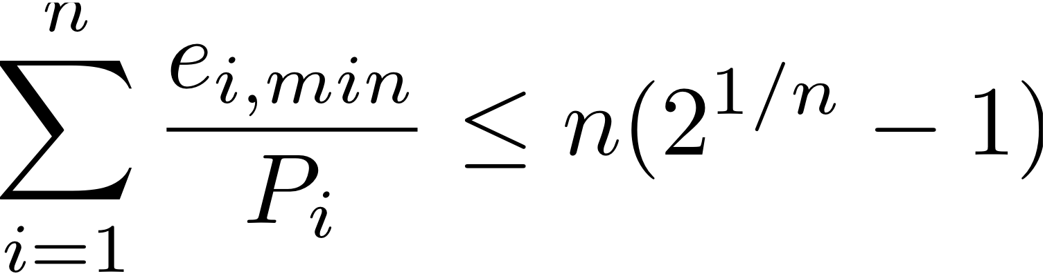
Scheduling imprecise tasks
Tasks are periodic with known period (P_{i}) and an execution time range [e_{i,min}, e_{i,max}]
e_{i,min} represents the mandatory execution required by each task
The accuracy of a task is highest when each job executes for e_{i,max} time units
First step
Ensure that the mandatory portions of all tasks are schedulable
If tasks are scheduled with rate monotonic priorities, we can use the Liu & Layland bound

Slide 32
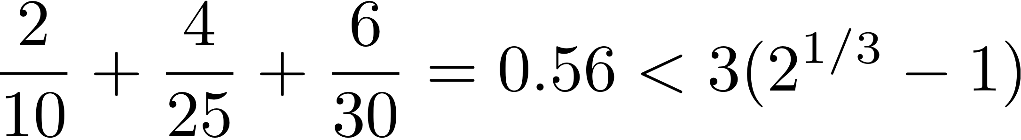
Example task set
Task | e_{min} | e_{max} | P
T1 | 2 | 7 | 10
T2 | 4 | 8 | 25
T3 | 6 | 10 | 30
The mandatory portion of this task set is schedulable.

Slide 33
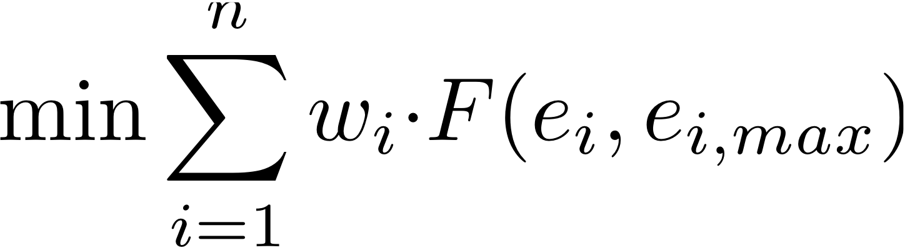
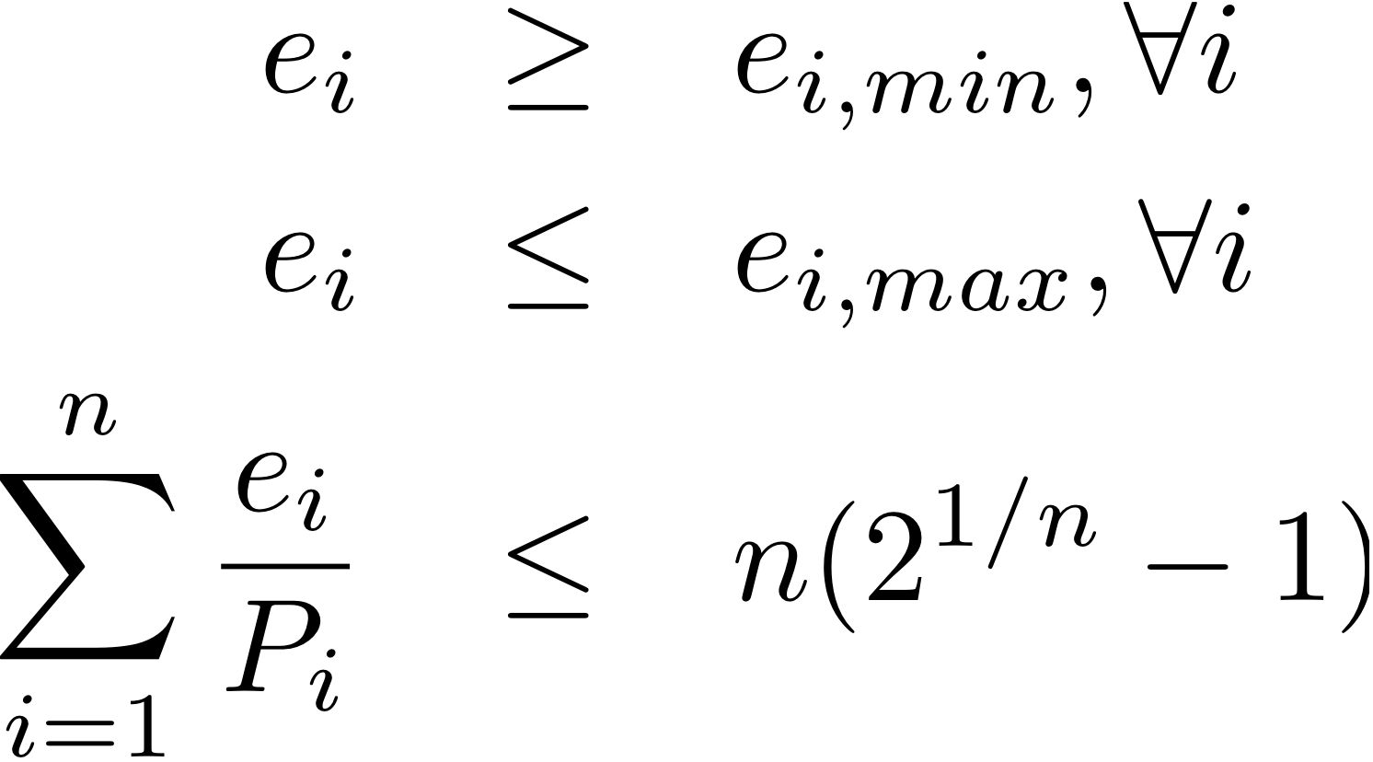
Scheduling imprecise tasks
Once we have ensured that the mandatory portions are schedulable, we have many options
The loss in accuracy for each task can be specified by some error function F
Let e_{i} be the execution time of T_{i}; then the error is some function of e_{i} and e_{i,max}
We could decide to minimize the (weighted) sum of errors
How do we find the values for {e_{i}} that minimize the error?
Objective function
Relative importance of the tasks
Subject to constraints
Linear program formulation
Constraints on execution time
Schedulability constraint

Slide 34
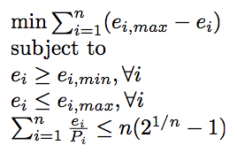
A simple error function
F(e_{i,max}, e_{i}) = e_{i,max} – e_{i} is a simple error function
Let us also assume that the weight of each task is 1.
A simple linear program

Slide 35
Solving the linear program
Task | E_{min} | E_{max} | P
T1 | 2 | 7 | 10
T2 | 4 | 8 | 25
T3 | 6 | 10 | 30
Greedy algorithm
Intuition: increasing the execution time of a task by x decreases error by x.
The task with the largest period has the least utilization penalty.
Determine 1/P_{i} for each task. This is the utilization penalty for increasing the execution time of T_{i} by 1 time unit.
Simplifying assumption: execution times are integers (or can be represented as integers).
Start off by setting the execution times of all tasks to their minimum
Increase the execution time of the task with the smallest utilization penalty to the maximum extent possible.
Then move to the task with the next smallest utilization penalty.
Repeat until the utilization bound is reached or no further progress is possible.

Slide 36
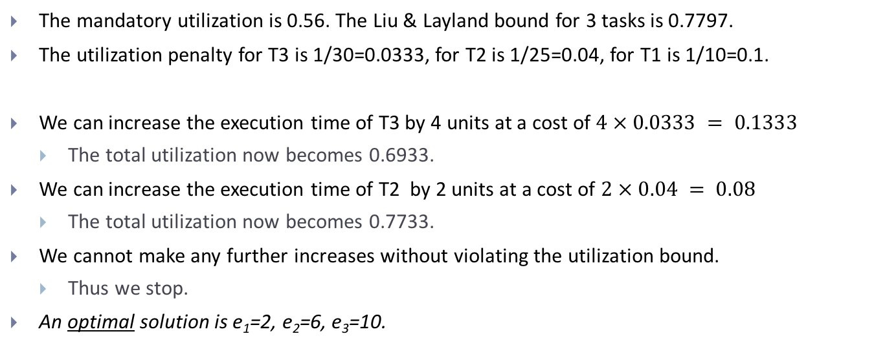
Solving the linear program
Task | E_{min} | E_{max} | P
T1 | 2 | 7 | 10
T2 | 4 | 8 | 25
T3 | 6 | 10 | 30
The mandatory utilization is 0.56. The Liu & Layland bound for 3 tasks is 0.7797.
The utilization penalty for T3 is 1/30=0.0333, for T2 is 1/25=0.04, for T1 is 1/10=0.1.
We can increase the execution time of T3 by 4 units at a cost of $4 × 0.0333 = 0.1333$
The total utilization now becomes 0.6933.
We can increase the execution time of T2 by 2 units at a cost of $2 × 0.04 = 0.08$
The total utilization now becomes 0.7733.
We cannot make any further increases without violating the utilization bound.
Thus we stop.
An optimal solution is e₁=2, e₂=6, e₃=10.

Slide 37
Highlights
We examined another task model for providing good QoS for soft real-time systems.
The imprecise computation model trades off execution time for accuracy.
Different applications need different approaches to obtaining good quality of service.
For each task parameter, we have studied some mechanism by which they can be controlled and the entire system behaves in a “predictable” manner.

Slide 38
What you should know
What is the imprecise computation model?
Why, and where, is it useful?
How do you decide execution times under this model?
Solve for the simple case of linear error function.
Ponder: Can we use elastic scheduling when tasks have variable execution times? What should the parameters for such task sets be?

